Slide 1
Enabling Distributed Event Management: Interoperability for Automated Response and Prevention
Sean Barnum
George Saylor
Aug 2011

Slide 2
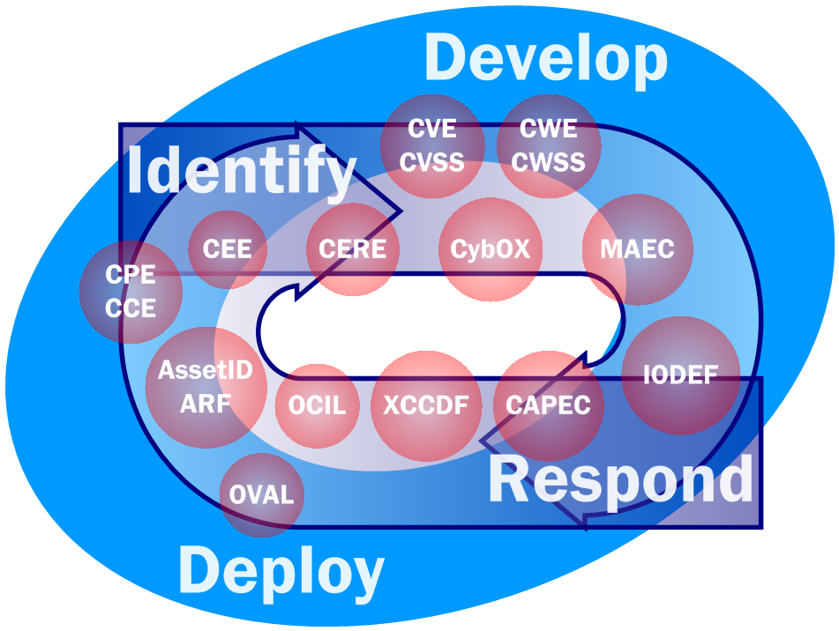

Slide 3
Premise
Supporting attack detection and automated courses of action in today’s advanced threat environment requires integration and correlation of diverse sets of event producers as well as standardized structured event representations to support interoperability
Solution Resources
Event Management Automation Protocol (EMAP)
Cyber Observable eXpression (CybOX)

Slide 4
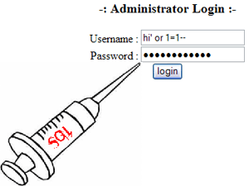
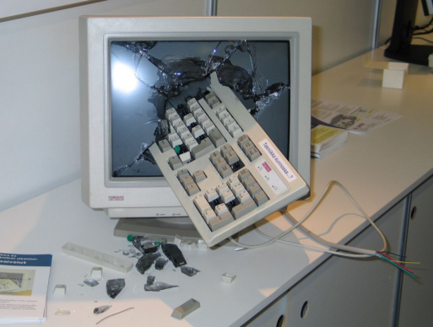
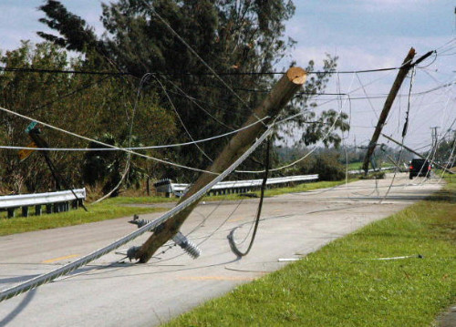
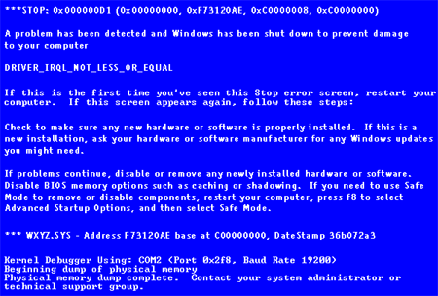
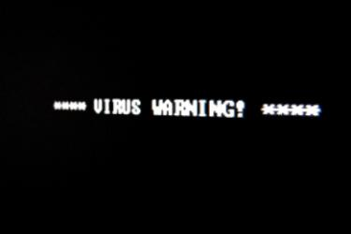
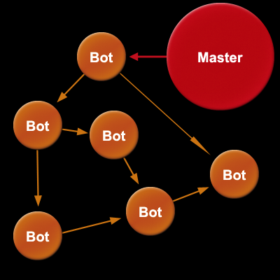
The Problem
Lots of events, all in different formats

Slide 5
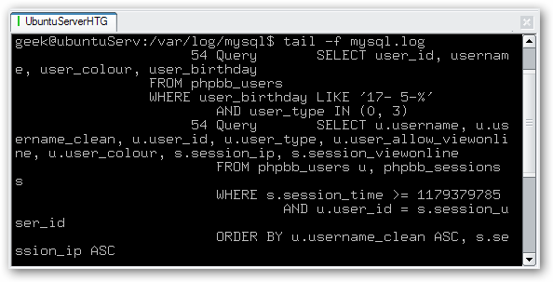
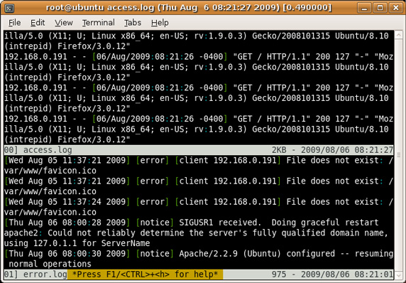
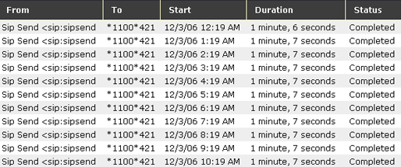
The Problem (Continued)

Slide 6
What is EMAP?
A program to establish a protocol to enable standardized content, representation, exchange, correlation, searching, storing, prioritization, and auditing of event records within an organizational IT environment
A specification to meet these goals and define how relevant technical specifications will interact to achieve the desired outcomes.
Develop and implement validation of products that conform to the standard

Slide 7
What is EMAP? (Continued)
Languages
Express logs and policies
Metrics
Event scoring
framework
Enumerations
Convention for
identifying and naming
Common Log formats
Log correlation rules
Logging configuration
Audit Settings
Normalization
Incident Description
Observable Description
Severity of logged events
Criticality
Impact
Log taxonomy
Enrichment information
Observables
(U)
Notes:
What and How
7

Slide 8
Event Funnel
# of events
firewalls
intrusion detection
antivirus/malware
vulnerability scans
system/application
millions
enumerations
thousands
normalization
languages
hundreds
correlation
metrology
prioritized
threats
tens

Slide 9
How it all works
PARSE
FILTER
CORRELATE

Slide 10
Notional EMAP Components
Common Event Expression (CEE)
A suite of specifications to define taxonomy, syntax, transport, logging recommendations, and parsing information about event records
Open Event Expression Language (OEEL)
A language to express parsing and normalization logic using CEE Profiles to convert event records into CEE
Common Event Rule Expression (CERE)
A common format to express rules for pattern matching, filtering, and correlation

Slide 11
Notional EMAP Components
Common Event Scoring System (CESS)
A specification that provides metrics of event severity and impact based on multiple factors
Cyber Observable eXpression (CybOX)
A language to express cyber observable events or stateful measures that provides a common foundation for many of the other standards

Slide 12
CEE Components
CEE Dictionary
CEE Taxonomy (CEET)
Common Event Log Recommendations (CELR)
Common Log Syntax (CLS)
Common Log Transport (CLT)

Slide 13
CEE Architecture

Slide 14
OEEL
Provide a standardized ability to represent parsing logic external to the parsing application
Provide vendors and consumers to express and share parsing logic in a standard format
Simplify product development
A way to change a native log into a standard format (example Apache to CEE)
Combine multiple log and data sources together into common output

Slide 15
CERE
Provide vendors and consumers a way to express and share rules for pattern matching, correlation, and filtering of logs
Support distributed multi-vendor enterprises
Aid in acquisition
Simplify sharing detection rules to public
Achieve this with minimal impact to vendors and consumers

Slide 16
CESS
Provide a metric for scoring the severity, criticality, and impact of a given event, set of events, or incident
Leverage EMAP components to derive reasonably accurate scoring
Use CESS to assist in filtering and correlation
Provide vendors, responders, analysts a reliable and repeatable means of calculating and sharing this information

Slide 17
Enabling Automated Response and Prevention
Interoperability
Mapping observables and indicators to detection rules
Mapping attack patterns to observables and detection rules
Mapping malware characteristics to observables and rules
Incident Management automation through information exchange of standardized content

Slide 18
Cyber Observables Overview
The Cyber Observables construct is intended to capture and characterize events or properties that are observable in the operational domain.
These observable events or properties can be defined in rules or used to adorn the appropriate portions of the attack patterns in order to tie the logical pattern constructs to real-world evidence of their occurrence or presence for attack detection and characterization.
By capturing them in a structured fashion, the intent is to enable future potential for detailed automatable mapping and analysis heuristics.

Slide 19
Cyber observables apply to numerous domains
Detailed attack patterns
Malware characterization
Operational Events
Logging
Cyber situational awareness
Incident response
Forensics
Etc.

Slide 20
A Brief History of Cyber Observables
September 2009: Concept introduced to CAPEC in Version 1.4 as future envisioned adornment to the structured Attack Execution Flow
June 2010: Broader relevance to MSM recognized leading to CAPEC, MAEC & CEE teams collaborating to define one common structure to serve the common needs
August 2010: Discussed with US-CERT at GFIRST 2010
December 2010: Cyber Observables schema draft v0.4 completed
December 2010: Discussions with Mandiant for collaboration and alignment between Cyber Observables and Mandiant OpenIOC
January 2011: Discussed & briefed with MITRE CSOC
February 2011: Discussed & briefed with NIST – EMAP and US-CERT who also have a need for this construct and had begun to work on parallel solutions
May 2011: Schematic alignment and integration with CEE

Slide 21
Common Cyber Observables (CybOX) Schema
Measure
Stateful_Measure
Action
Observable
Event
Measure Source
Object State
Object
Defined Object
File System
GUI
IPC
Internet
Module
Registry
Memory
Network
Daemon
Custom Attributes

Slide 22
Common Cyber Observables (CybOX) Schema
Measure
Stateful_Measure
Action
Observable
Event
Measure Source
Object State
Object
Defined Object
File System
GUI
IPC
Internet
Module
Registry
Memory
Network
Daemon
Custom Attributes

Slide 23
Common Cyber Observables (CybOX) Schema
Measure
Stateful_Measure
Action
Observable
Event
Measure Source
Object State
Object
Defined Object
File System
GUI
IPC
Internet
Module
Registry
Memory
Network
Daemon
Custom Attributes

Slide 24
Various Defined Object Schemas
Account
Disk
Disk Partition
DNS Cache
Email Message
File
GUI
Library
Package
Memory
Network Connection
Network Route
Linux Package
Product
Service
Socket
System
User Session
Volume
Win Critical Section
Win Driver
Win Event
Win Event Log
Win Kernel
Win Kernel Hook
Win Handle
Win Mailslot
Win Mutex
Win Named Pipe
Win Network Route
Win Prefetch
Win Registry
Win Semaphore
Win System Restore
Win Task
Win Thread
Win Waitable Timer
X509 Certificate
…
(more on the way)

Slide 26
Cyber Observable Use Cases
Potential ability to analyze data from all types of tools and all vendors
Improved sharing among all cyber observable stakeholders
Detect malicious activity from attack patterns
Empower & guide incident management
Identify new attack patterns
Prioritize existing attack patterns based on tactical reality
Ability to metatag cyber observables for implicit sharing controls
Enable automated signature rule generation
Enable new levels of meta-analysis on operational cyber observables
Potential ability to automatically apply mitigations specified in attack patterns
Etc….

Slide 27
Use Case: Detect Malicious Activity
Current:
Manual effort to pull together data across many sensors
Results in limited situational awareness
Attack patterns and rules are typically too detailed (physical signatures) or ambiguous prose
High level of effort
High false negatives & positives
CybOX-enabled:
Diverse set of sensors output data in common format
Attack patterns and rules can be defined in a uniform fashion
Pattern matching and analysis heuristics can be easily automated

Slide 28
Use Case: Incident Response Data Capture
Current:
Very manual
Inconsistent between analysts & organizations
Prose-based and imprecise
Difficult to automate capture and actionable alerts
CybOX-enabled:
Improved consistency
Ability to tie everything together
Simplified and automated data capture
Alerts become actionable for automation

Slide 29
Use Case: Malware Analysis
Current:
Difficult to combine different analysis perspectives or tools
Difficult to share info
Difficult to recognize if malware has been seen before
Does not scale well
CybOX(MAEC)-enabled:
Easier to integrate different forms of analysis, different tools and even information from different sources
Easier to share information
Easier to recognize malware (including variants and pertubations)
Enables automated interaction among the various dimensions of malware analysis

Slide 30
Use Case: Malware Artifact Hunting
Current:
Very manual
Often imprecise and inconsistent
Localized
CybOX(MAEC)-enabled:
Very automated
Consistent
Enables broad, non-localized sharing and hunting

Slide 31
Use Case: Host Based Detection
Dynamic Analysis Engine
Anubis
CWSandbox
ThreatExpert
Etc.
Engine Output
Malware Binary
Sandbox -> MAEC Translator
Host-based Scanner

Slide 32
Use Case: IR/IM Alerts
Current:
Typically unstructured prose
Labor intensive and slow
Limited actionable (in an automated fashion) data
CybOX-enabled:
Structured and consistent
Alert generation can be much faster and less labor intensive
Potentially actionable in an automated context

Slide 33
Notional Flow of a Modern Security Incident
An attack on an information system occurs involving social engineering, vulnerability exploit, malware + command and control (C2).
CybOX-enabled operational sensors (IDS, host-based, etc.) pick up anomalous activity and report it in CEE/CybOX formats.
Automated analysis tools & rules attempt to match anomalous activity against CybOX-adorned CAPEC attack patterns but discover no matching patterns.
Incident is reported – Incident Response/Management process is initiated.
IR personnel capture discovered detail of incident in CybOX-compliant formats, including CEE.
IR personnel detect malware as part of the ongoing attack.

Slide 34
Notional Flow of a Modern Security Incident
Notional Flow of a Modern Security Incident (cont.)
Malware undergoes automated analysis (dynamic and/or static) and results are captured in MAEC (CybOX-integrated) language.
Malware analysts are able to correlate the current malware instance with a broad range of pre-existing malware samples and analysis data from MAEC-enabled repositories and zoos.
Malware analysts capture new discovered detail of the malware in MAEC format, including the CWE or CVE exploited .
Sample and analysis data from current malware instance are entered into appropriate malware repositories and zoos.
CybOX observables of malware effects on hosts are extracted from MAEC content to generate OVAL checks to determine if any given host has been infected/affected by the current malware instance.
OVAL checks are distributed and run against other areas of the domain or enterprise to determine breadth of compromise.

Slide 35
Notional Flow of a Modern Security Incident (cont.)
IR/IM personnel apply appropriate mitigations/remediations to negate the effects of the attack.
A new CAPEC attack pattern is authored to describe this new observed attack behavior, and is adorned as appropriate with CybOX content observed for this pattern in the operational space.
IR/IM personnel issue relevant alerts for the observed incident including the new CAPEC pattern, MAEC bundle and related CEE/CybOX content.
Secure development takes advantage of this new CAPEC pattern to: define/refine appropriate security policy, training & requirements; guide security engineering (control selection), architectural risk analysis, secure code review and security testing; identify relevant CWE weaknesses, CVE vulnerabilities & CCE configuration issues; prioritize relevant CAPEC patterns based on real-world observed prevalence/frequency profiled through automated observation of CybOX patterns in the operational space .

Slide 36
Where is CybOX today?
Currently integrated into CAPEC
Currently integrated into MAEC
In process of being integrated into CEE
Part of the strategic approach for EMAP
Part of the strategic vision for IR/IM with US-CERT
Continued integration discussions planned for Mandiant OpenIOC once initial drafts of Object schemas are complete
Currently being evaluated for integration into multiple research projects
Website should be up soon

Slide 37
Questions / Comments?
Sean Barnum
sbarnum@mitre.org
George Saylor
george.saylor@nist.gov
EMAP Developer Days (Aug 29-30) – NIST
http://scap.nist.gov/events
ITSAC (Oct 31 - Nov 2) – Crystal City

