Slide 1
A (very) Brief Introduction to the Cyber Observables eXpression (CybOX)
IT Security Automation Conference
October 31st 2011

Slide 2
What is a “Cyber Observable”?
a measurable event or stateful property in the cyber domain
What is the “Cyber Observable eXpression”?
a standardized means for representing cyber observables, i.e. a schema

Slide 3
Some examples of CybOX measureable events
A registry key is created
A file is deleted
An HTTP Get Request is received
An IDS rule fired
…
a few examples
Some examples of CybOX stateful properties
MD5 hash of a file
Value of a registry key
Existence of a mutex
…

Slide 4
What are the indicators of a specific cyber incident?
What are the indicators of a family of malware?
What are the indicators of a specific pattern of cyber attack?
CybOX is intended to help here…

Slide 5
CybOX gives us a standardized way to represent this behavior
Storm Worm:
1. Drops a rootkit
2. Starts it as a service
Event:
Create file: C:\Windows\spooldr.exe
Event:
Create registry entry: Key=SYSTEM/CurrentControlSet\Services\spooldr
Hive=HKEY_LOCAL_MACHINE
Simple Example: Storm Worm

Slide 6
Mandiant
OpenIOC-format Data Stream
MAEC-format Data Stream
CybOX-format Data Stream
Other
Data Streams
(over time)
OVAL checks

Slide 7
Cyber Observable eXpression (CybOX) Use Cases ITSAC 2011
http://cybox.mitre.org
Sean Barnum
Rich Struse
Oct 2011

Slide 8
Cyber Observables Overview
The Cyber Observable eXpression (CybOX) is a standardized language for encoding and communicating high-fidelity information about cyber observables, whether dynamic events or stateful measures that are observable in the operational cyber domain.
CybOX is not targeted at a single cyber security use case but rather is intended to be flexible enough to offer a common solution for all cyber security use cases requiring the ability to deal with cyber observables.
It is also intended to be flexible enough to allow both the high-fidelity description of instances of cyber observables that have been measured in an operational context as well as more abstract patterns for potential observables that may be targets for observation and analysis apriori.
By specifying a common structured schematic mechanism for these cyber observables, the intent is to enable the potential for detailed automatable sharing, mapping, detection and analysis heuristics.

Slide 9
Cyber Observables Apply to Numerous Domains
Threat assessment & characterization (detailed attack patterns)
Malware characterization
Operational event management
Logging
Cyber situational awareness
Incident response
Forensics
Etc.

Slide 10
Through utilization of the standardized CybOX language, relevant observable events or properties can be
captured and shared,
defined in rules
or used to adorn the appropriate portions of attack patterns and malware profiles in order to tie the logical pattern constructs to real-world evidence of their occurrence or presence for attack detection and characterization.
Incident response and management can then take advantage of all of these capabilities to investigate occurring incidents, improve overall situational awareness and improve future attack detection, prevention and response.

Slide 11
The Role of Cyber Observables in Interoperability
Characterizing event records or streams as standardized observables
[observable isComposedOf event]
Mapping observables to detection rules
[observable isModeledBy detectionRule]
Mapping attack patterns to observables
[attackPatternElement isExposedBy observable]
Mapping malware characteristics to observables
[malwareCharacteristic isExposedBy observable]
Incident Management automation through information exchange of standardized observables-based content

Slide 12
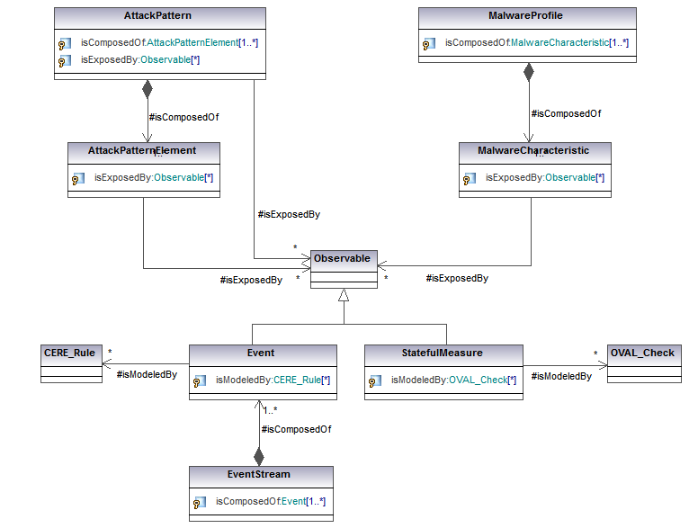
CAPEC
IR/IM
MAEC
CybOX
CEE

Slide 13
A Brief History of Cyber Observables
September 2009: Originally introduced as part of CAPEC adornment to the structured Attack Execution Flow
June 2010: Broader relevance to MSM recognized leading to CAPEC, MAEC & CEE teams collaborating to define one common structure to serve the common needs
August 2010: Discussed with US-CERT at GFIRST 2010
December 2010: Cyber Observables schema draft v0.4 completed
December 2010: Discussions with Mandiant for collaboration and alignment between Cyber Observables and Mandiant OpenIOC
January 2011: Discussed & briefed with MITRE CSOC
February 2011: Discussed & briefed with NIST – EMAP and US-CERT who also have a need for this construct and had begun to work on parallel solutions
May 2011: Schematic alignment and integration with CEE
May 2011: Spun off as independent effort called the Cyber Observable eXpression (CybOX)
Oct 2011: CybOX website launched with initial schema Version 0.6

Slide 14
Common Cyber Observables (CybOX) Schema
Measure
Stateful
Measure
Action
Observable
Event
Measure Source
Object State
Object
Defined Object
File System
GUI
IPC
Internet
Module
Registry
Memory
Network
Daemon
Custom Attributes

Slide 15
Various Defined Object Schemas
Account
Disk
Disk Partition
DNS Cache
Email Message
File
GUI
Library
Package
Memory
Network Connection
Network Route
Linux Package
Product
Service
Socket
System
User Session
Volume
Win Critical Section
Win Driver
Win Event
Win Event Log
Win Kernel
Win Kernel Hook
Win Handle
Win Mailslot
Win Mutex
Win Named Pipe
Win Network Route
Win Prefetch
Win Registry
Win Semaphore
Win System Restore
Win Task
Win Thread
Win Waitable Timer
X509 Certificate
…
(more on the way)

Slide 16
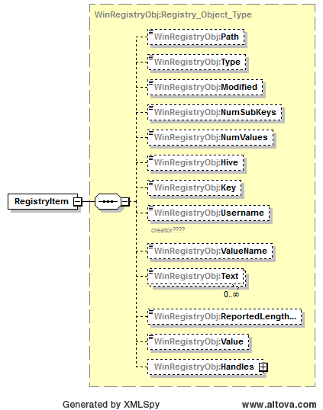

Slide 17
Wide Range of Cyber Observable Use Cases
Potential ability to analyze data from all types of tools and all vendors
Improved sharing among all cyber observable stakeholders
Detect malicious activity from attack patterns
Empower & guide incident management
Identify new attack patterns
Prioritize existing attack patterns based on tactical reality
Ability to metatag cyber observables for implicit sharing controls
Enable automated signature rule generation
Enable new levels of meta-analysis on operational cyber observables
Potential ability to automatically apply mitigations specified in attack patterns
Etc….

Slide 18
Common Cyber Observables (CybOX) Schema
Measure
Stateful
Measure
Action
Observable
Event
Measure Source
Object State
Object
Defined Object
File System
GUI
IPC
Internet
Module
Registry
Memory
Network
Daemon
Custom Attributes

Slide 19
Common Cyber Observables (CybOX) Schema
Measure
Stateful
Measure
Action
Observable
Event
Measure Source
Object State
Object
Defined Object
File System
GUI
IPC
Internet
Module
Registry
Memory
Network
Daemon
Custom Attributes

Slide 20
MAEC & CybOX
Before (MAEC 1.x)
MAEC
MAEC Entities
MAEC Objects
After (MAEC 2.0 and up)
MAEC
CybOX
Defined Object
MAEC Entities
Defined Object
Object Type
Defined Object Type
Defined Object
Imports
Substitutes

Slide 21
Malware Community Engagement
IEEE Industry Connections Security Group (ICSG)
Malware Working Group developed an exchange schema to facilitate the sharing of sample data between AV product vendors
MAEC currently imports the IEEE ICSG Malware Metadata exchange schema
Recently established Malware Metadata Exchange Format WG
Main Focus:
Adding capability to MMDEF schema for capturing blackbox behavioral metadata about malware
Will likely import MAEC/CybOX, especially MAEC Objects and Actions
Secondary Focus:
Adding capability to MMDEF schema for profiling clean (non-malicious) files, including software packages
Aimed at sharing information about clean files for reducing AV detection false positives
Potentially transition to a new IEEE standard

Slide 22
Common Cyber Observables (CybOX) Schema
Measure
Stateful
Measure
Action
Observable
Event
Measure Source
Object State
Object
Defined Object
File System
GUI
IPC
Internet
Module
Registry
Memory
Network
Daemon
Custom Attributes
Etc.
ICSG Malware WG
openIOC

Slide 23
Common Cyber Observables (CybOX) Schema
Measure
Stateful
Measure
Action
Observable
Event
Measure Source
Object State
Object
Defined Object
File System
GUI
IPC
Internet
Module
Registry
Memory
Network
Daemon
Custom Attributes

Slide 24
Notional EMAP Components
Common Event Expression (CEE)
A suite of specifications to define taxonomy, syntax, transport, logging recommendations, and parsing information about event records
Open Event Expression Language (OEEL)
A language to express parsing and normalization logic using CEE Profiles to convert event records into CEE
Common Event Rule Expression (CERE)
A common format to express rules for pattern matching, filtering, and correlation
Common Event Scoring System (CESS)
A specification that provides metrics of event severity and impact based on multiple factors
Cyber Observable eXpression (CybOX)
A language to express cyber observable events or stateful measures that provides a common foundation for many of the other standards

Slide 25
The Role of CybOX within EMAP
Role of CybOX with CEE
Comprehensive structure of CybOX enables CEE to support full spectrum of event capture and sharing use cases that enterprise cyber security would require of an EMAP.
Common underlying structure would allow CEE events to be an integral and automatable part of holistic IR/IM.
CEE controlled vocabulary, taxonomy and object model benefits from a much broader and richer stakeholder community
Role of CybOX with OEEL
CybOX offers architected structure for defining CEE Profiles and a strategically consistent basis for normalization and mapping from independent formats
Role of CybOX with CERE
CybOX offers architected structure for defining automatable patterns and rules that are universally consistent and useful within EMAP and interchangeably with other automation protocols

Slide 26
Incident Response/Management and the Common Cyber Observables (CybOX) Schema
Measure
Stateful
Measure
Action
Observable
Event
Measure Source
Object State
Object
Defined Object
File System
GUI
IPC
Internet
Module
Registry
Memory
Network
Daemon
Custom Attributes
Etc.
ICSG Malware WG
openIOC

Slide 27
Use Case: Malware Analysis
Current:
Difficult to combine different analysis perspectives or tools
Difficult to share info
Difficult to recognize if malware has been seen before
Does not scale well
CybOX(MAEC)-enabled:
Easier to integrate different forms of analysis, different tools and even information from different sources
Easier to share information
Easier to recognize malware (including variants and pertubations)
Enables automated interaction among the various dimensions of malware analysis

Slide 28
MAEC(CybOX) Use Cases
Analysis
Help Guide Analysis Process
Standardized Tool Output
Malware Repositories
Tool
Tool

Slide 29
<maec:MAEC_Bundle schema_version="2.0">
<maec:Behaviors>
<maec:Behavior id="maec:storm:bhv:1" ordinal_position="1" successful="true">
<maec:Description>A Storm Worm behavior that instantiates itself as a rootkit-enabled binary on a system</maec:Description>
<maec:Actions>
<maec:Action id="maec:storm:act:1" ordinal_position="1" type="Create">
<maec:Description>Storm first drops the malicious binary on the system</maec:Description>
<maec:Affected_Objects>
<maec:Affected_Object effect_type="Created" target_object_id="maec:storm:obj:1"/>
</maec:Affected_Objects>
</maec:Action>
<maec:Action id="maec:storm:act:2" ordinal_position="2" type="Create">
<maec:Description>Storm then instantiates the binary as a service</maec:Description>
<maec:Affected_Objects>
<maec:Affected_Object effect_type="Created" target_object_id="maec:storm:obj:2"/>
</maec:Affected_Objects>
</maec:Action>
</maec:Actions>
</maec:Behavior>
</maec:Behaviors>
<maec:Objects>
<maec:Object id="maec:storm:obj:1" Type="File">
<observables:Defined_Object xsi:type="WinFileObj:Windows_File_Object_Type">
<FileObj:File_Name>spooldr.exe</FileObj:File_Name>
<FileObj:Full_Path>C:\Windows</FileObj:Full_Path>
</observables:Defined_Object>
</maec:Object>
<maec:Object id="maec:storm:obj:2" Type="Key/Key Group">
<observables:Defined_Object xsi:type="WinRegistryObj:Windows_Registry_Object_Type">
<WinRegistryObj:Hive>HKEY_LOCAL_MACHINE</WinRegistryObj:Hive>
<WinRegistryObj:Key>SYSTEM/CurrentControlSet\Services\spooldr</WinRegistryObj:Key>
</observables:Defined_Object>
</maec:Object>
</maec:Objects>
</maec:MAEC_Bundle>
Portion of MAEC
Analysis of Storm
Worm

Slide 30
Use Case: Detect Malicious Activity
Current:
Manual effort to pull together data across many sensors
Results in limited situational awareness
Attack patterns and rules are typically too detailed (physical signatures) or ambiguous prose
High level of effort
High false negatives & positives
CybOX-enabled:
Diverse set of sensors output data in common format
Attack patterns and rules can be defined in a uniform fashion
Pattern matching and analysis heuristics can be easily automated

Slide 31
<Observables>
<Observable>
<Measure>
<Pattern>
<Event Type="File Ops (CRUD)">
<Description>Storm drops a rootkit enabled binary on the system</Description>
<Action Name="Create">
<Object Type="File" Action_Role="Target">
<Defined_Object xsi:type="WinFileObj:Windows_File_Object_Type">
<FileObj:File_Name>spooldr.exe</FileObj:File_Name>
<FileObj:Full_Path>C:\Windows</FileObj:Full_Path>
</Defined_Object>
</Object>
</Action>
</Event>
</Pattern>
</Measure>
</Observable>
<Observable>
<Measure>
<Pattern>
<Event Type="Registry Ops">
<Description>Storm creates a registry key to load itself as a service</Description>
<Action Name="Create">
<Object Type="Key/Key Group" Action_Role="Target">
<Defined_Object xsi:type="WinRegistryObj:Windows_Registry_Object_Type">
<WinRegistryObj:Hive>HKEY_LOCAL_MACHINE</WinRegistryObj:Hive>
<WinRegistryObj:Key>SYSTEM/CurrentControlSet\Services\spooldr</WinRegistryObj:Key>
</Defined_Object>
</Object>
</Action>
</Event>
</Pattern>
</Measure>
</Observable>
</Observables>
CybOX Content Transformed from Portion of MAEC
Analysis of Storm
Worm

Slide 32
Use Case: Malware Artifact Hunting
Current:
Very manual
Often imprecise and inconsistent
Localized
CybOX(MAEC)-enabled:
Very automated
Consistent
Enables broad, non-localized sharing and hunting

Slide 33
Use Case: Host Based Detection
Dynamic Analysis Engine
Anubis
CWSandbox
ThreatExpert
Etc.
Engine Output
Malware Binary
Sandbox -> MAEC Translator
Host-based Scanner

Slide 34
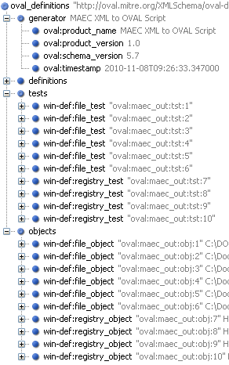
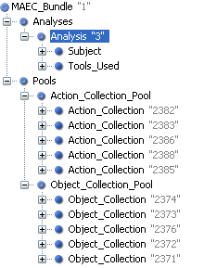
Real World Example: MAEC & Zeus Bot
OVAL Output
Anubis Output*
Anubis → MAEC Translator Script
MAEC Output
Anubis Sandbox
MAEC → OVAL Translator Script
Zeus Binary
*http://anubis.iseclab.org/?action=result&task_id=1167a57d1aa905e949df5d5478ab23bf9

Slide 35
<oval_definitions>
<definitions>
<definition class="compliance" id="oval:storm:def:1" version="1">
<metadata>
<title>Storm Worm Test</title>
<affected family="windows"/>
<description>A test for a file and a registry key associated with the Storm Worm</description>
</metadata>
<criteria operator="AND">
<criterion comment="File test" test_ref="oval:storm:tst:1"/>
<criterion comment="Registry key test" test_ref="oval:storm:tst:2"/>
</criteria>
</definition>
</definitions>
<tests>
<win-def:file_test id="oval:storm:tst:1" version="1" check="all" comment="test for a Storm file" check_existence="all_exist">
<win-def:object object_ref="oval:storm:obj:1"/>
</win-def:file_test>
<win-def:registry_test id="oval:storm:tst:2" version="1" check="all" comment="test for a Storm registry key" check_existence="all_exist">
<win-def:object object_ref="oval:storm:obj:2"/>
</win-def:registry_test>
</tests>
<objects>
<win-def:file_object id="oval:storm:obj:1" version="1">
<win-def:path>C:\System</win-def:path>
<win-def:filename>spooldr.exe</win-def:filename>
</win-def:file_object>
<win-def:registry_object id="oval:storm:obj:2" version="1">
<win-def:hive>HKEY_LOCAL_MACHINE</win-def:hive>
<win-def:key>SYSTEM/CurrentControlSet\Services\spooldr</win-def:key>
<win-def:name xsi:nil="true"/>
</win-def:registry_object>
</objects>
</oval_definitions>
OVAL Checks Transformed from Portion of MAEC
Analysis of Storm
Worm

Slide 36
Use Case: Incident Response Data Capture
Current:
Very manual
Inconsistent between analysts & organizations
Prose-based and imprecise
Difficult to automate capture and actionable alerts
CybOX-enabled:
Improved consistency
Ability to tie everything together
Simplified and automated data capture
Alerts become actionable for automation

Slide 37
Use Case: IR/IM Alerts
Current:
Typically unstructured prose
Labor intensive and slow
Limited actionable (in an automated fashion) data
CybOX-enabled:
Structured and consistent
Alert generation can be much faster and less labor intensive
Potentially actionable in an automated context

Slide 38
Notional Flow of a Modern Security Incident
An attack on an information system occurs involving social engineering, vulnerability exploit, malware + command and control (C2).
CybOX-enabled operational sensors (IDS, host-based, etc.) pick up anomalous activity and report it in CEE/CybOX formats.
Automated analysis tools & rules attempt to match anomalous activity against CybOX-adorned CAPEC attack patterns but discover no matching patterns.
Incident is reported – Incident Response/Management process is initiated.
IR personnel capture discovered detail of incident in CybOX-compliant formats, including CEE.
IR personnel detect malware as part of the ongoing attack.

Slide 39
Notional Flow of a Modern Security Incident
Notional Flow of a Modern Security Incident (cont.)
Malware undergoes automated analysis (dynamic and/or static) and results are captured in MAEC (CybOX-integrated) language.
Malware analysts are able to correlate the current malware instance with a broad range of pre-existing malware samples and analysis data from MAEC-enabled repositories and zoos.
Malware analysts capture new discovered detail of the malware in MAEC format, including the CWE or CVE exploited .
Sample and analysis data from current malware instance are entered into appropriate malware repositories and zoos.
CybOX observables of malware effects on hosts are extracted from MAEC content to generate OVAL checks to determine if any given host has been infected/affected by the current malware instance.
OVAL checks are distributed and run against other areas of the domain or enterprise to determine breadth of compromise.

Slide 40
Notional Flow of a Modern Security Incident (cont.)
IR/IM personnel apply appropriate mitigations/remediations to negate the effects of the attack.
A new CAPEC attack pattern is authored to describe this new observed attack behavior, and is adorned as appropriate with CybOX content observed for this pattern in the operational space.
IR/IM personnel issue relevant alerts for the observed incident including the new CAPEC pattern, MAEC bundle and related CEE/CybOX content.
Secure development takes advantage of this new CAPEC pattern to: define/refine appropriate security policy, training & requirements; guide security engineering (control selection), architectural risk analysis, secure code review and security testing; identify relevant CWE weaknesses, CVE vulnerabilities & CCE configuration issues; prioritize relevant CAPEC patterns based on real-world observed prevalence/frequency profiled through automated observation of CybOX patterns in the operational space .

Slide 41
Where is CybOX today?
Currently integrated into CAPEC
Currently integrated into MAEC
In process of being integrated into CEE
Part of the strategic approach for EMAP
Part of the strategic vision for IR/IM with US-CERT
Continued integration discussions planned for Mandiant OpenIOC once initial drafts of Object schemas are complete
Currently being evaluated for integration into multiple research projects
Website should be up soon

Slide 42
Timeline
Initial CybOX Schemas released with CAPEC v1.6
CEE v0.6 Released
Have some internal mappings to CybOX
Formalized, released in next update
MAEC 2.0 update leveraging CybOX coming out within a few weeks
Revised CybOX to be released EOFY11
Support limited OS & host-based objects
Limited or no network observables

Slide 43
Questions / Comments?
Sean Barnum
sbarnum@mitre.org
ITSAC (Oct 31 - Nov 2) – Crystal City

